Slide 1
School Module Training
Presented By:
Lucía Lapaz, Brittany Ersery & Jim Holsinger
Envision Technology Partners, Inc.
September 2019

Slide 2
Agenda
Education Module Overview
School Nurse Reports

Slide 3
Education Module

Slide 4
Add/Edit School Enrollment
Search for and select patient
Navigate to Education screen
Add/Edit School Enrollment, including:
School District
School
Enrollment Date
Optional Fields:
Student ID
Grade Level
FERPA Consent Date
Unenrollment may be entered on the same screen

Slide 5
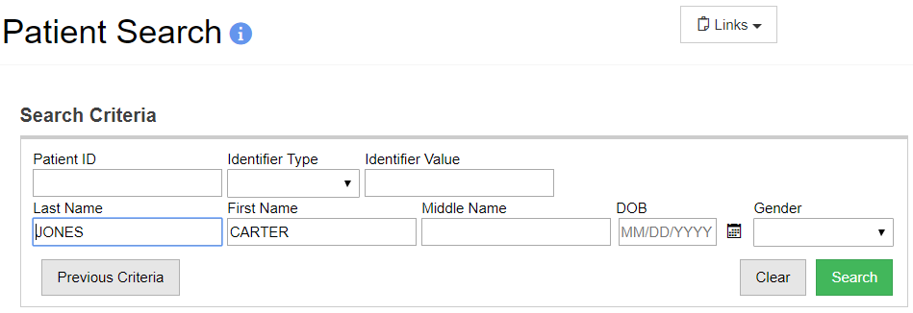
Search for Patient
1
2
Enter patient search criteria.
Click Search.

Slide 6
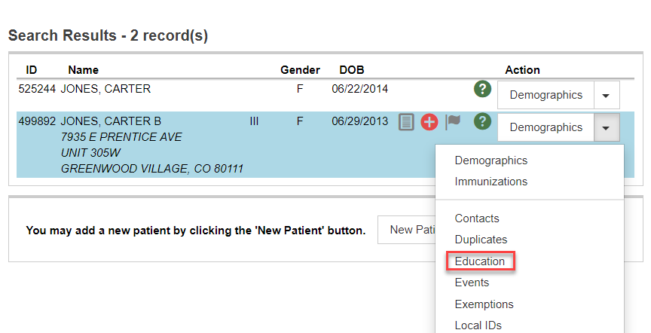
Select Patient
1
2
Open menu next to desired patient.
Click Education.

Slide 7
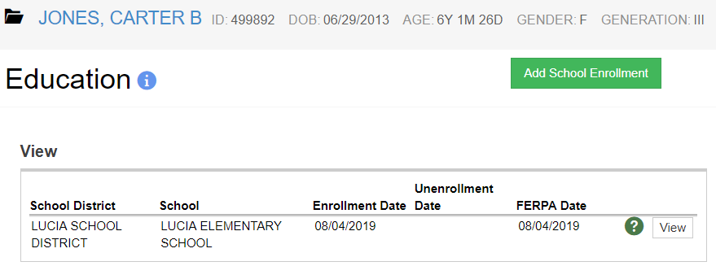
School Enrollment
1
2
Click to Add School Enrollment.
Click View and/or update enrollment.

Slide 8
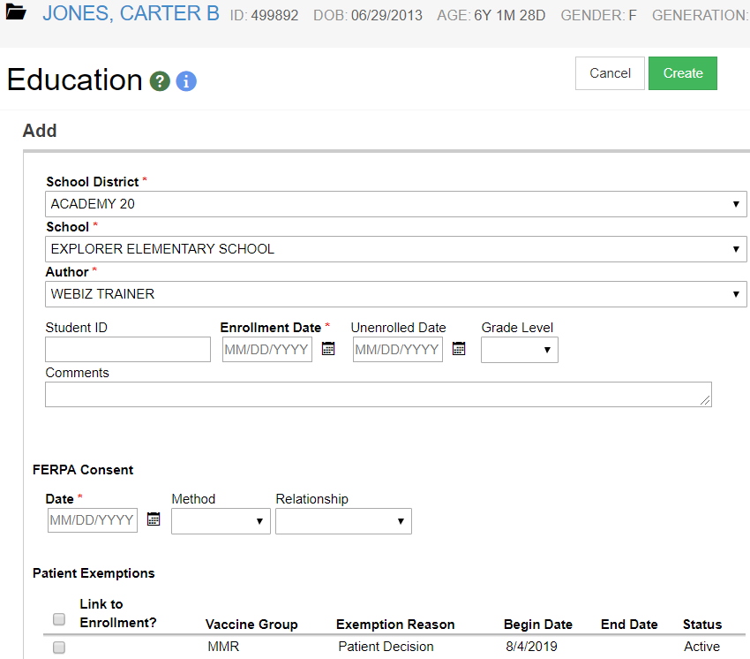
Add School Enrollment
2
1
Complete required fields.
Click to Create enrollment.

Slide 9
Add an Enrollment
Hands-On Exercise

Slide 10
School Nurse Reports

Slide 11
Immunization Rates (School Version)
Calculates percent of student patients up-to-date on recommended immunizations
View coverage rates by antigen(s) or by vaccine series
Results are based on the Recommender, thus, invalid doses are not counted
Identify student patients not up-to-date

Slide 12
Patient Reminder / Recall (School Version)
Generate a list of student patients due and/or overdue for vaccinations
Choose from a variety of search criteria to target students included in the reminder/recall
Reminder/recall runs are processed nightly

Slide 13
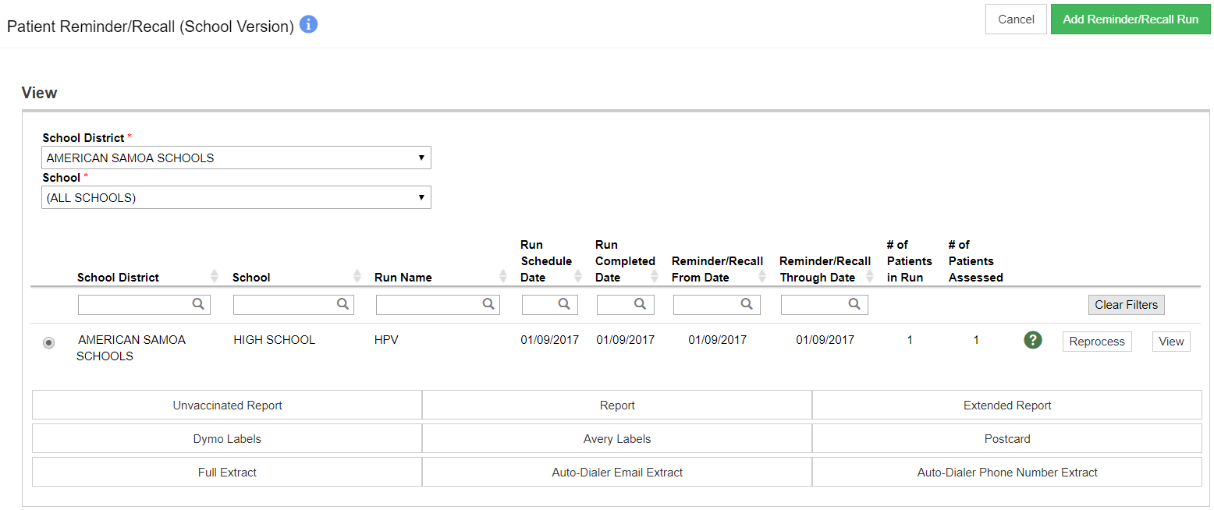
Patient Reminder / Recall (cont.)
1
3
2
Add a new Reminder/Recall run.
View existing Reminder/Recall criteria.
Reprocess a Reminder/Recall after records of student patients included in initial run have been changed.

Slide 14
Reminder / Recall Output
Unvaccinated Report: Lists student patients meeting Reminder/Recall criteria that have not returned for immunizations since the reminder/recall was run.
Report: Lists all student patients meeting Reminder/Recall criteria.

Slide 15
Reminder / Recall Output (cont.)
Dymo Labels: Generates a set of address labels designed to be printed on a Dymo Label printer.
Avery Labels: Generates a set of address labels designed to be printed on Avery 5160 style labels.
Postcard: Generates a report suitable to print pre-formatted reminder postcards.
Full Extract: Generates a CSV file containing all data for student patients included in the Reminder/Recall.

Slide 16
Reminder / Recall Output (cont.)
Auto-Dialer Email Extract: Generates a CSV file containing Patient Email Address, Patient ID, and Patient Name for patients included in the Reminder/Recall.
Auto-Dialer Phone Number Extract: Generates a CSV file containing Patient Phone Number, Patient ID, and Patient Name for patients included in the Reminder/Recall.

Slide 17
Patients with Notes
View students with notes on their record
Report filters include:
School District / School
Note Type(s)
Note Date Range
Available in both PDF and Extract
Notes:
In addition to report filter criteria, output includes patient ID, patient first and last name, patient DOB, patient gender, note author, note text.

Slide 18
School Roster File Import
Enables the ability to upload school enrollments per school
Creates a new school enrollment if none previously recorded
Updates patient demographic information
Patient must previously exist in ShowMeVax and be an exact match for school enrollment to be created
Will not create new patients
See School Roster Spec document for further details

Slide 19
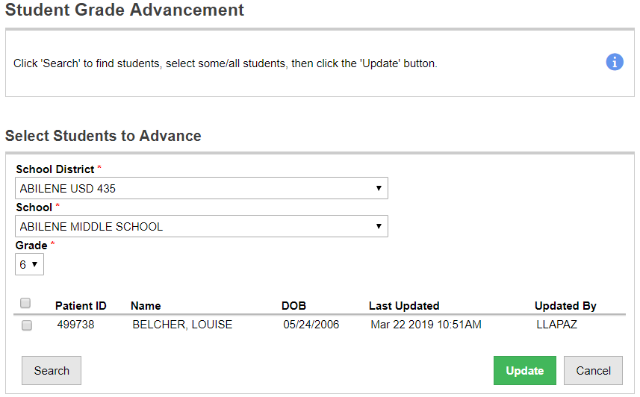
Student Grade Advancement
Interactive screen that allows school users to advance students from one grade to the next
Search for students with open enrollments for the school district/school and the grade level specified
Select the students to advance and click Update

Slide 20
Student Roster
Generates a list of students with open enrollments
Output can be grouped by School District/School or by County

Slide 21
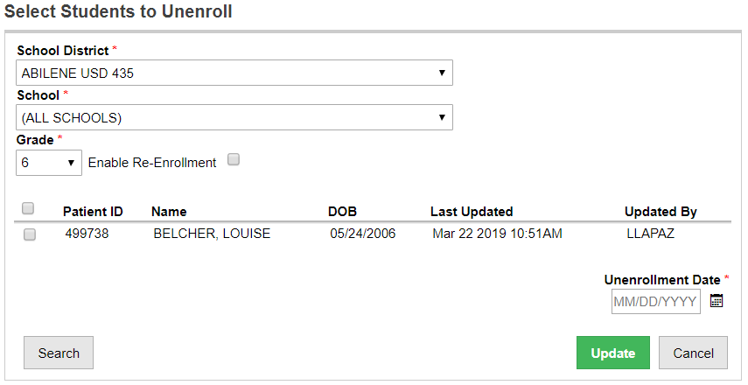
Student Unenrollment
Interactive screen that allows school users to unenroll students from a school (i.e., graduating seniors)
Search for students with open enrollments for the school district/school and the grade level specified
Select the students to advance and click Update

Slide 22
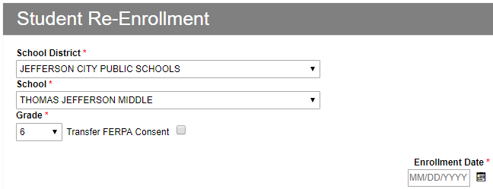
Enable Re-Enrollment
Feature on Student Unenrollment report
Enroll student(s) in a new school during the unenrollment process, i.e., moving from elementary to middle school

Slide 23
Student with Active Exemptions
Generates a list of students with one or more vaccine exemptions
Two report types:
Statistical Summary
Patient View
Output includes:
Number of patients by each exempted vaccine
Percentage of exempted patients
Available as PDF or extract

Slide 24
Patients with Precautions / Contraindications
Generates a list of patients with selected Precautions / Contraindications by School District / School
Report filters include:
School District / School
Precautions / Contraindications
Effective Date Range
Available in both PDF and Extract

Slide 25
School Nurse Reports
Hands-On Exercise

